Slide 1
Mass Incarceration – An overview
Kairos Prison Ministry International Conference
Dr. Karen Swanson, Institute for prison ministries

Slide 2
terms
Mass incarceration – (over incarceration, the prison boom) – comparatively and historically extreme rates of imprisonment in the U.S.
Biblical justice - making individuals, communities, and the cosmos whole, by upholding both goodness and impartiality. (Paul Metzger)
Restorative justice – A process where:
  The needs of the victim(s) are met
  The offender is held accountable, responsible to repair the harm
  It involves those impacted in the process of restoration (Howard Zehr)

Slide 3
The facts

Slide 4
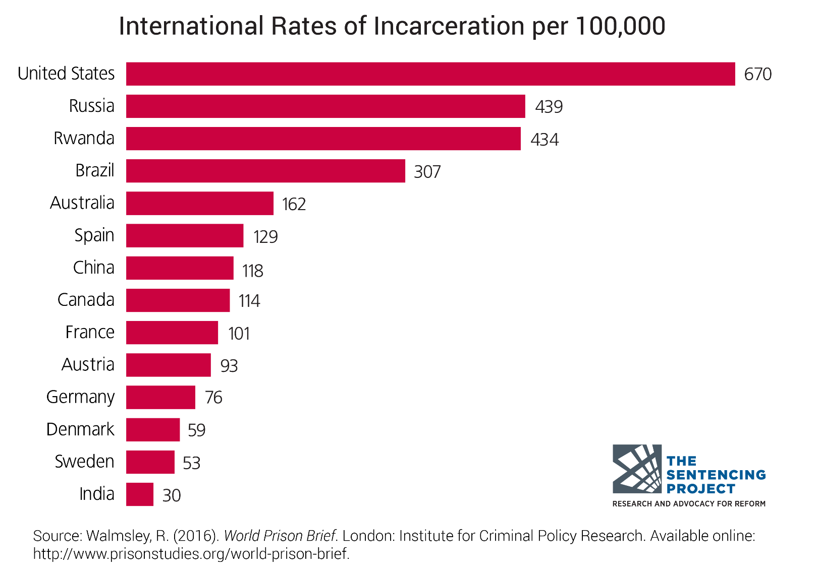
International Rates of Incarcerations, 2016

Slide 5
U.S. Incarceration
U.S. has 5% of the world’s population and
more than 20% of the world’s
incarcerated population.

Slide 6
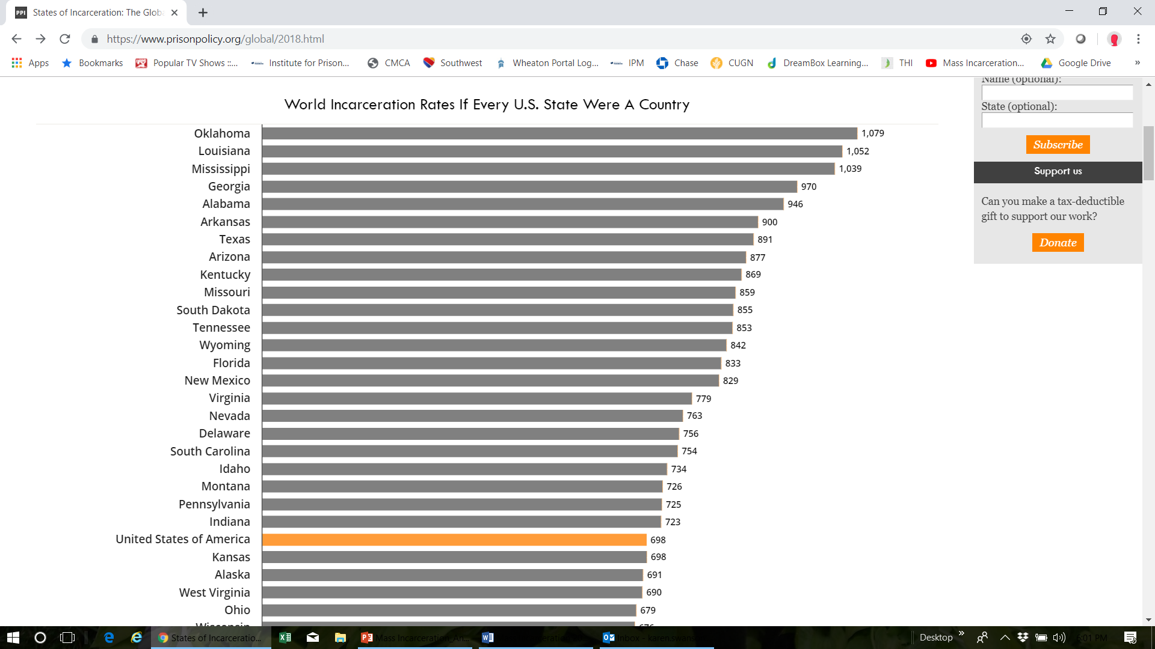

Slide 7
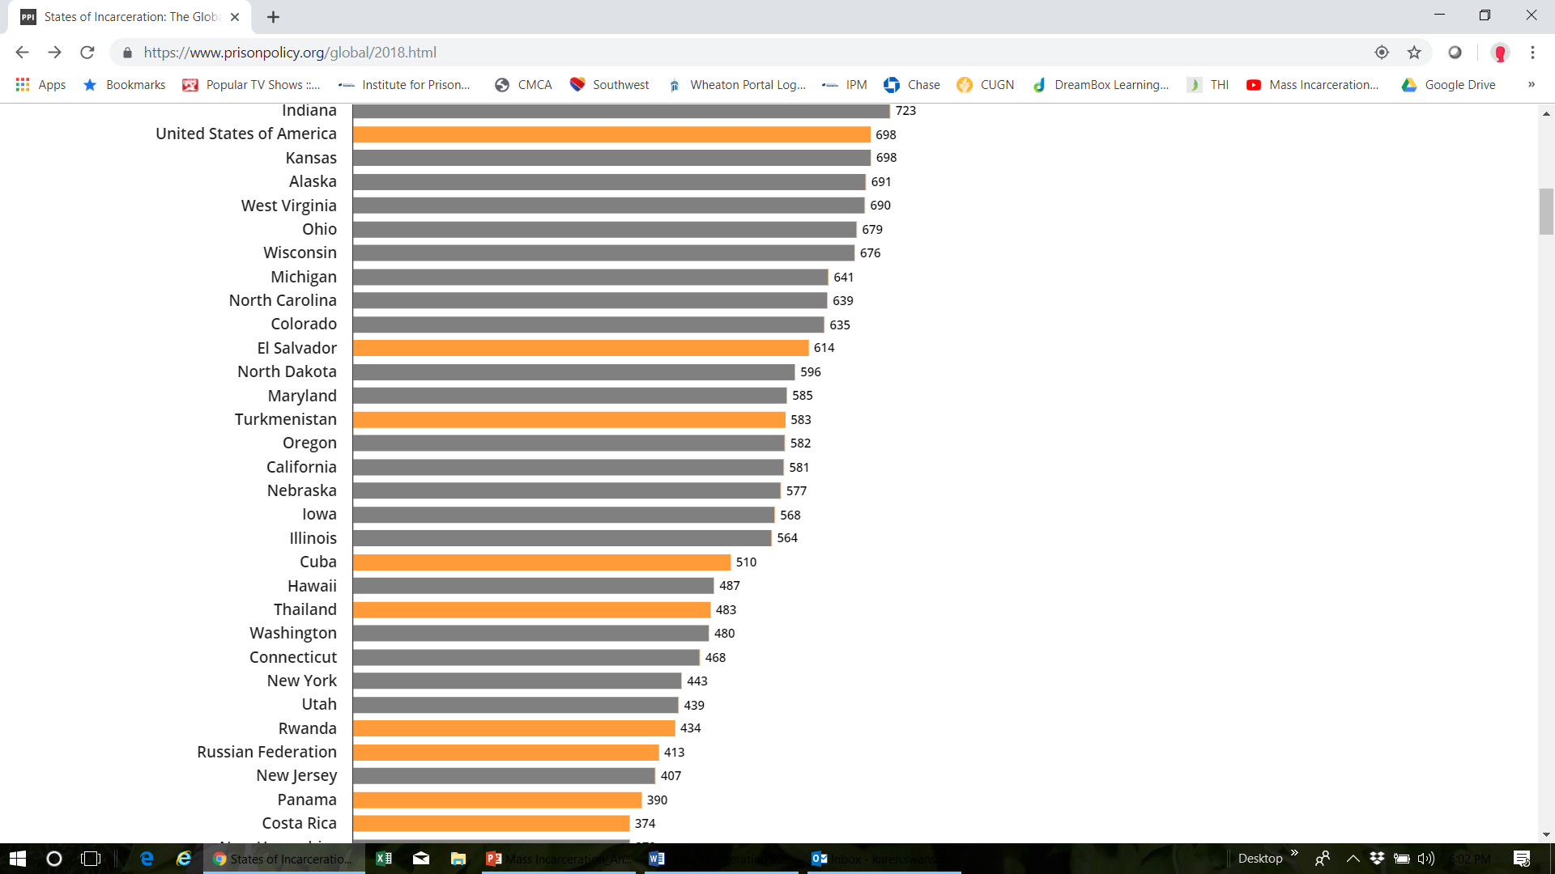

Slide 8
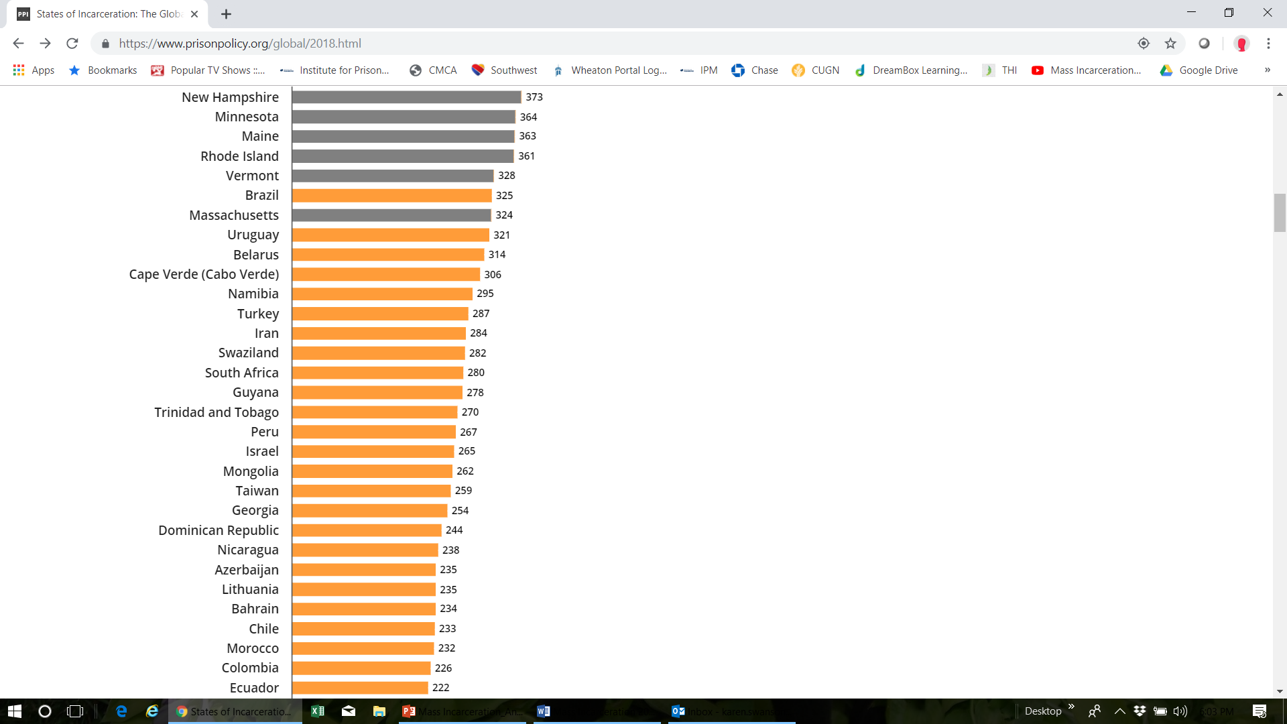

Slide 9
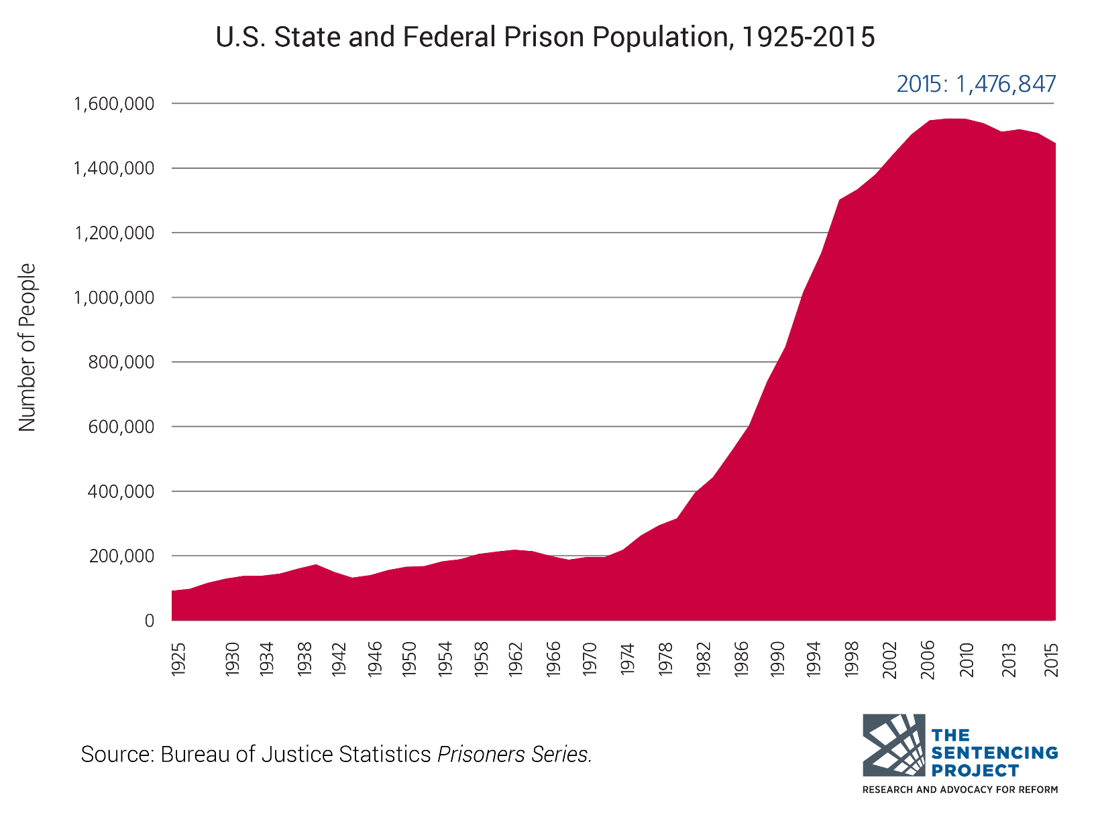
The Era of Mass Incarceration

Slide 10
Population under control of the U.s. corrections system, 1980 and 2016 (Bjs, 2018)

Slide 11
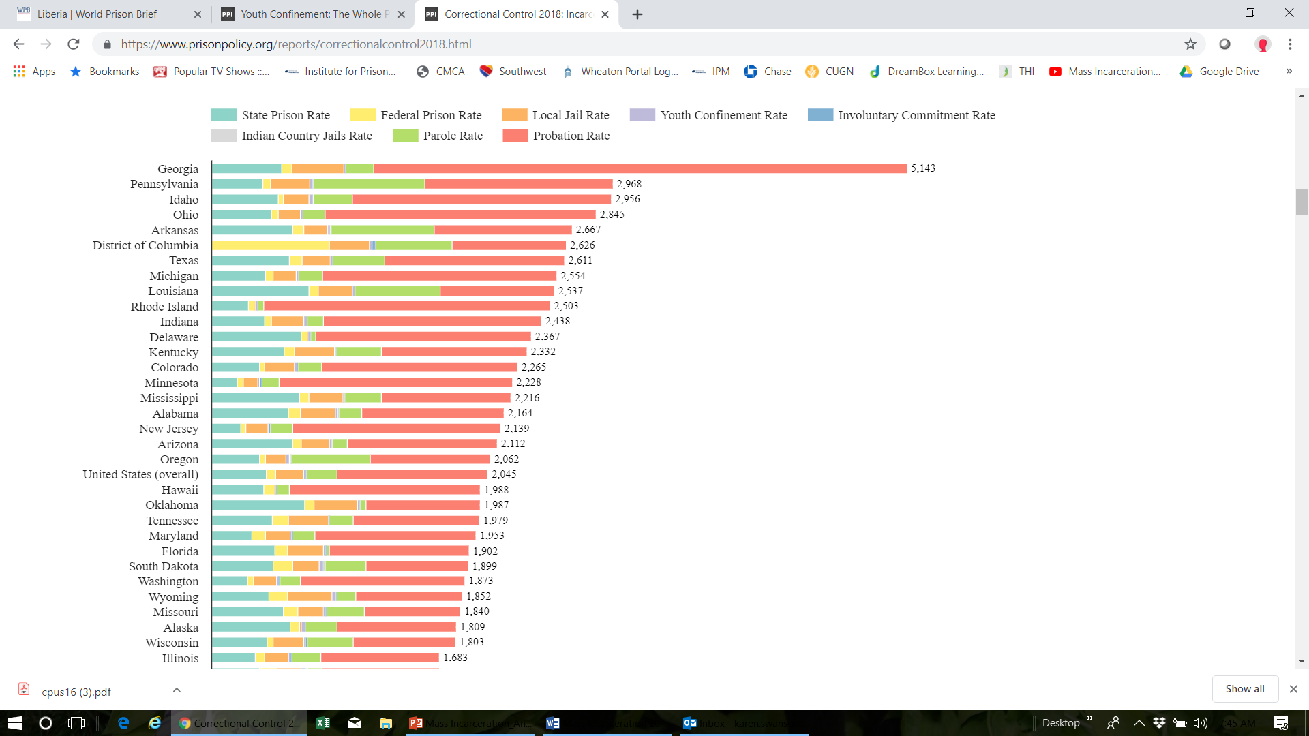

Slide 12
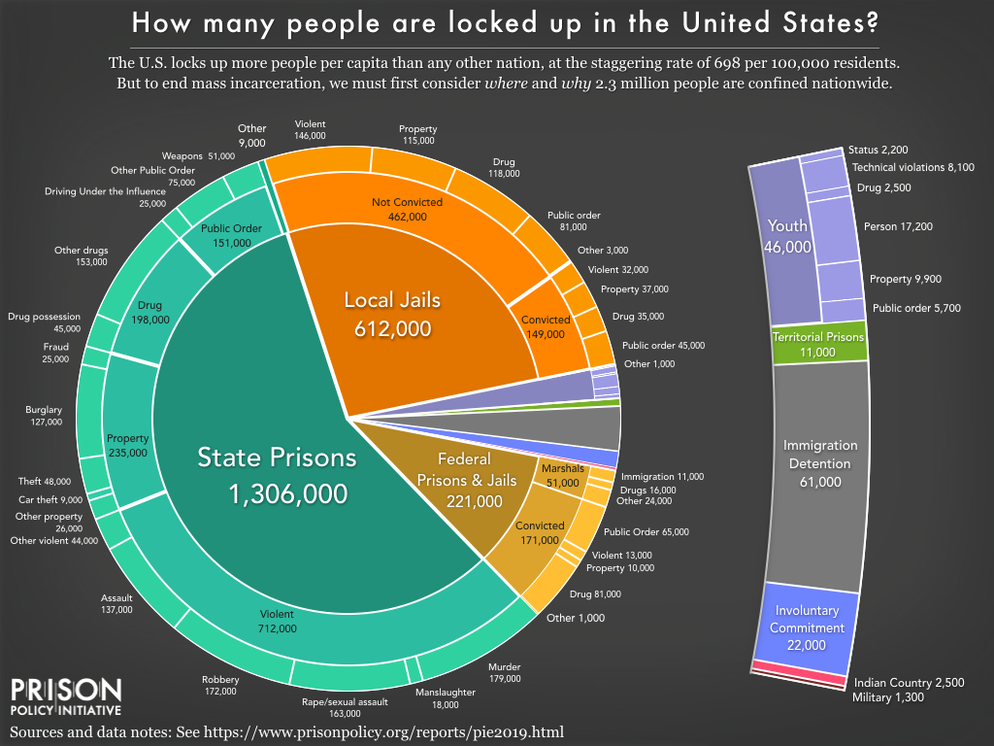

Slide 13
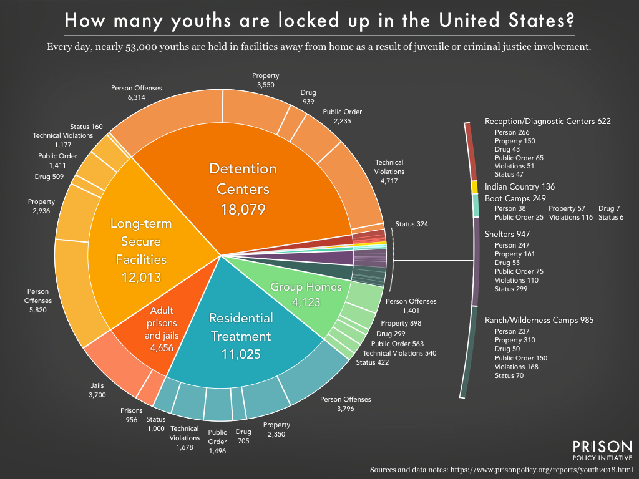

Slide 14
Youth Offenses
Some children and youth become involved with the juvenile justice system because they are accused of committing a delinquent or criminal act. Other youth come into contact with the system for status offenses—actions that are illegal only because of a youth’s age—such as truancy, underage drinking, and running away from home. Not all of these cases, however, are formally processed through the courts.

Slide 15
Jails and prisons national statistics
JAILS (3100+)
PRISONS (1719 State, 102 Federal)
County
All security levels together
76% pretrial; 24% convicted (few hours to years) Ave. 25 days
Men and women in separate parts of the same facility (except large jails)
Trend – 84% of jails held people out of their jurisdiction
State, Federal, private (<5%)
Designated security levels
Convicted (sentenced >1 yr)
Separate facilities by gender/security level

Slide 16
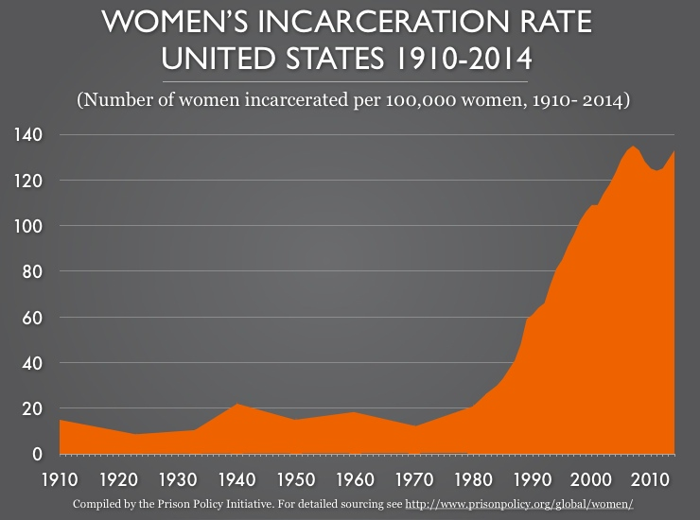

Slide 17
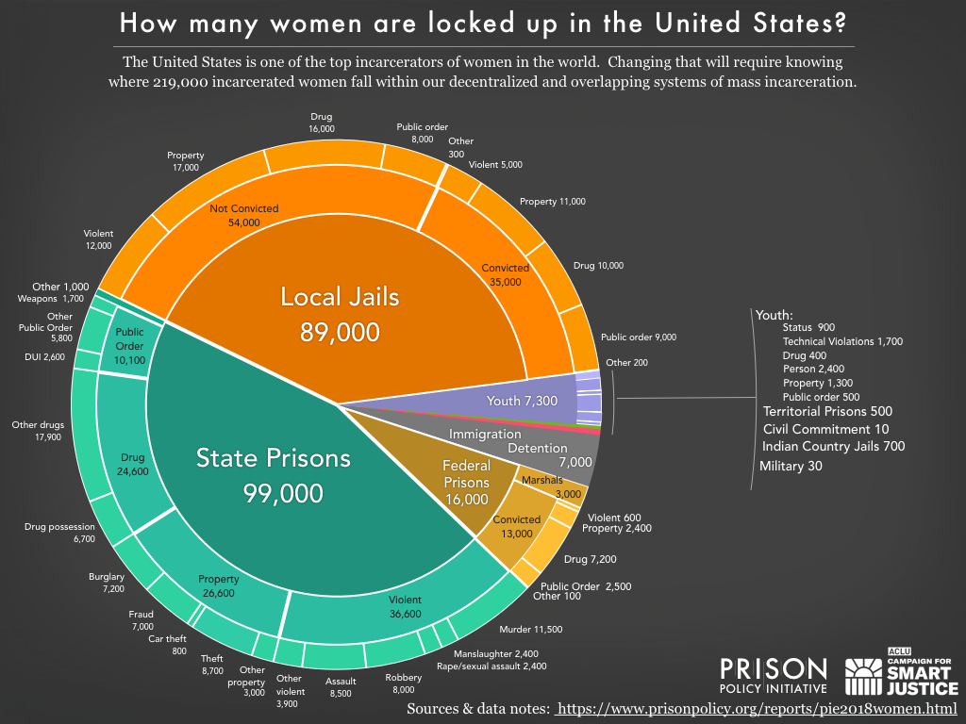

Slide 18
Women
7% of prison population, 15% of jail population
More likely to be incarcerated for non-violent offenses than males - property and drug crimes
Gender specific strategies needed
Notes:
Women 6.8% in prisons (2017)
https://www.bop.gov/about/statistics/statistics_inmate_gender.jsp

Slide 19
Test your knowledge
The racial disparity within the inmate population in the U.S. is unjust
Strongly agree
Somewhat agree
Somewhat disagree
Strongly disagree
Not sure

Slide 20
The racial disparity within the inmate population in the u.S. is unjust

Slide 21
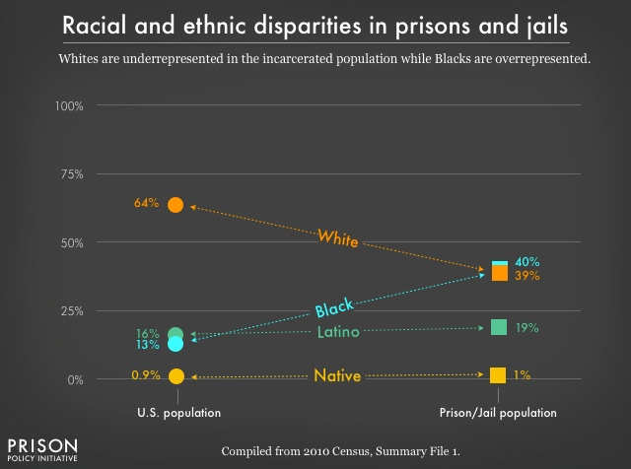

Slide 22
Racial Disparities
From arrest to sentencing, racial and ethnic disparities are a defining characteristic of our criminal justice system. Not only does racial bias pervade the justice process; people of color also face disproportionately high rates of poverty, meaning they suffer from the justice system's unequal treatment of poor people. Black Americans, in particular, are disproportionately likely to be incarcerated and to receive the harshest sentences, including death sentences. (Source: Prison Policy)

Slide 23
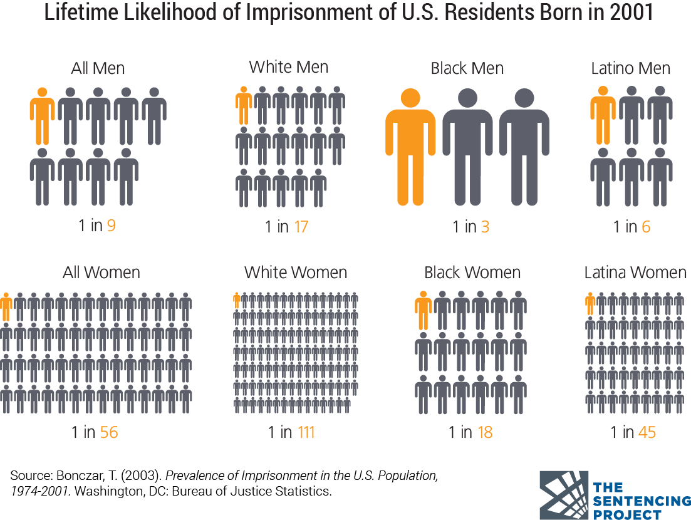
Lifetime Likelihood of Imprisonment

Slide 24
Test your knowledge
What percentage of the incarcerated in the U.S. will one day be released back into their communities?
  95%
  85%
  75%
  65%

Slide 25
Recidivism (30 State study)
44% were arrested within 1 year after release.
Within 5 years of release, 76.6% were rearrested.
Within 9 years of release, 83% were rearrested.

Slide 26
What doesn’t work
Locking people up
Locking people up longer

Slide 27
Why prisons fail by judge challeen
WE WANT THEM TO HAVE SELF-WORTH…So we destroy their self-worth.
WE WANT THEM TO BE RESPONSIBLE…So we take away all responsibilities.
WE WANT THEM TO BE PART OF OUR COMMUNITY…So we isolate them from our community.
WE WANT THEM TO BE KIND AND LOVING PEOPLE…So we subject them to hate and cruelty.

Slide 28
Why prisons fail
WE WANT THEM TO QUIT BEING THE TOUGH GUY…So we put them where the tough guy is respected.
WE WANT THEM TO QUIT HANGING AROUND LOSERS…So we put all the losers in the state under one roof.
WE WANT THEM TO BE POSITIVE AND CONSTRUCTIVE…So we degrade them and make them useless.
WE WANT THEM TO BE TRUSTWORTHY…So we put them where there is no trust.

Slide 29
Why prisons fail
WE WANT THEM TO BE NON-VIOLENT…So we put them where there is violence all around them.
WE WANT THEM TO QUIT EXPLOITING US…So we put them where they exploit each other.
WE WANT THEM TO THINK LIKE NORMAL PEOPLE…So we put them where their fellow inmates think as they do…reinforcing each other’s losing beliefs and life style.
WE WANT THEM TO TAKE CONTROL OF THEIR LIVES, OWN THEIR PROBLEMS AND QUIT BEING PARASITES…So we make them totally dependent on us.

Slide 30
How did this happen?

Slide 31
Who is responsible?
Individuals
Systemic/cultural/community
Both

Slide 32
Philosophical Reasons
Shift in philosophy in the 1980’s from rehabilitation to retribution (punishment).
Increased focus on individual responsibility for crime
Imprisonment was the response to social problems of the poor – homelessness, unemployment, drug addiction, mental illness, and illiteracy.

Slide 33
Political reasons
Capitalizing on fears
  War on Drugs
  Tough on Crime

Slide 34
Policy changes
3 Strikes laws
Longer sentencing
Mandatory Minimums
Life sentences for youth

Slide 35
Policy Changes
Experts on crime and punishment now generally agree that changes in public policies—not dramatic changes in criminal behavior—propelled the decades-long prison boom in the United States.
Marie Gottschalk, Caught: The Prison State and the Lockdown of American Politics

Slide 36
Economic Reasons – Prison industry complex
Prison staff unions
Private prison companies
Public bond dealers
Suppliers of services and products used in corrections

Slide 37
Societal systemic reasons
Over-policing in designated areas
Poor education systems
Inadequate legal representation for the indigent
Racism

Slide 38
The Impact of Mass Incarceration on the Poor
“In this country it is better to be wealthy and guilty than poor and innocent.”
Bryan Stevenson, Just Mercy

Slide 39
Spiritual reasons
Support for retribution/silence of the church on justice issues
Focus on ministry - not justice (justice includes fair laws and fair application of the laws)
Willing to go into prisons but not willing to welcome formerly incarcerated in our churches

Slide 40
Pipelines

Slide 41
Cradle to Prison Pipeline: risk factors
Poverty
A culture of punishment rather than prevention
Inadequate access to health care
Gaps in early childhood development
Disparate educational opportunities
Intolerable abuse and neglect
Unmet mental and emotional problems
Substance abuse
Ineffective juvenile justice and child welfare systems
Sub-cultures that glorify violence and illegal occupations

Slide 42
Cradle to prison pipeline
CDF's vision with its Cradle to Prison Pipeline campaign is to reduce detention and incarceration by increasing preventive supports and services children need, such as access to quality early childhood development and education services and accessible, comprehensive health and mental health coverage.

Slide 43
At-Risk Youth
The “criminalized environment” facing Latino and African American children where “like the victims of a crippling or wasting disease, once drawn into the prison pipeline, massive numbers of young people lose their opportunity to live happy, productive lives, not because of festering microbes but because of years spend behind bars.”
Marian Wright Edelman, President of the Children’s Defense Fund

Slide 44
School to Prison Pipeline
“In these days, it is doubtful that any child may reasonably be expected to succeed in life if he is denied the opportunities of an education. Such an opportunity, where the state has undertaken to provide it, is a right that must be made available on equal terms.
Chief Justice Earl Warren, Brown v. Board of Education (1954)

Slide 45
School to Prison Pipeline: factors
  Zero tolerance policies
  Standardized testing
  Overzealous policing efforts
  Inadequate resources
  Lack of qualified teachers
  Insufficient funding for counselors, special education services, and textbooks
  Overcrowding classrooms

Slide 46
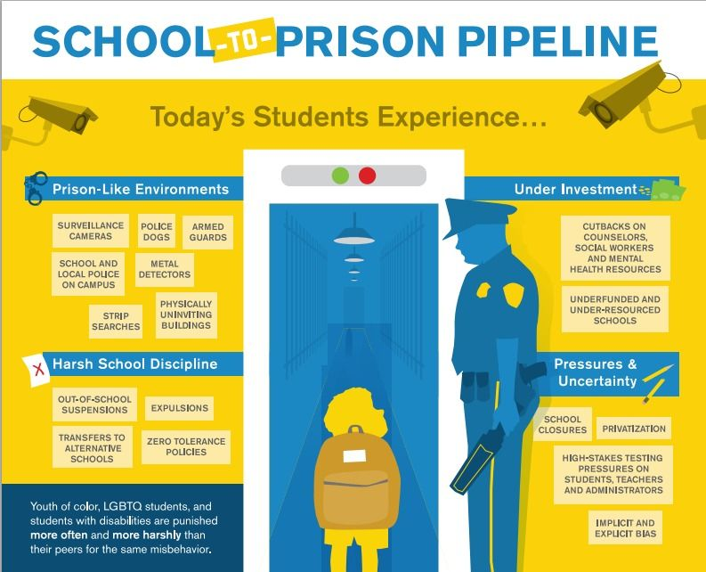
School to prison pipeline

Slide 47
Pathways to crime

Slide 48
pathways
Individual choices + life circumstances (family, community, etc.)

Slide 49
Pathways to crime for men: street men
ADDICTIONS
CRIME TO SUPPORT ADDICTION
MULTIPLE CONVICTIONS
DROPPED OUT OF SCHOOL

Slide 50
Pathways to crime for men: drug connected
FAMILY
CRIME
MANUFACTURE OR SALES

Slide 51
Pathways to crime for men: harm and harming
ABUSIVE CHAOTIC CHILDHOOD
CRIME

Slide 52
Pathways to crime for men: bad luck
CRIMINAL PEERS
CRIME

Slide 53
Pathways to crime for men: explosively violent
DRUG USE
CRIME
VIOLENT
DROPPED OUT OF SCHOOL
EARLIER CRIME
MORE CRIME

Slide 54
Pathways to crime for men: masculine gaming
CRIME IS FUN
RECREATIONAL
CRIME

Slide 55
Pathways to crime for women: street women
ABUSE
MENTAL ILLNESS
ADDICTION
CRIME
THEFT, PROSTITUTION

Slide 56
Pathways to crime for women: drug connected
FAMILY OR INTIMATE RELATIONS
CRIME
DRUG MANUFACTURE
SALES

Slide 57
Pathways to crime for women: harmed and harming
ABUSIVE
CHAOTIC CHILDHOOD
CRIME

Slide 58
Pathways to crime for women: battered women
BATTERED WOMEN
CRIME

Slide 59
Pathways to crime for women: “other”
ECONOMIC MOTIVATION
CRIME

Slide 60
CRIMINOGENIC FACTORS

Slide 61
Criminogenic Factors
Andrews, Bonta, & Wormth, 2006
Static Factors – Historical and cannot be changed by programming but can address other predictive factors that influence an offender’s current behavior, values, and attitudes.
  Age (age out of crime)
  Gender (females have different pathways to crime)
  Age of first offense (younger increases risk)
  Type of crime (violent or nonviolent)
Dynamic Needs – reflect current functioning and can be changed with programming.

Slide 62
Criminogenic Factors: dynamic factors (Men)
Andrews, Bonta, & Wormth, 2006
History of Anti-social Behavior*
Anti-social Personality Patterns
Anti-social Attitudes and Beliefs*
Anti-social Associates
Dysfunctional Family*
Lack of Employment Stability and Educational
Lack of Prosocial Activities
Substance Abuse*
*Women

Slide 63
FEMALE Risks/Needs
Relational Dysfunction
Child Abuse
Adult Victimization
Parental Involvement
Psychosis (symptoms)
Family Conflict
Depression/ Anxiety (symptoms)
Parental Stress
Housing Safety

Slide 64
Evidence-based practices
The more risks and needs addressed (that they have), the lower the recidivism

Slide 65
Build strengths
Self-efficacy (empower)
Self-esteem (prosocial identity)
Education
Family support (healthy)
Faith (beliefs, spiritual practices, community)

Slide 66
Restorative justice

Slide 67
Two Different Views--
Criminal Justice
Restorative Justice
Crime is a violation of the law and the state
Violations create guilt.
Justice requires the state to determine blame (guilt) and impose pain (punishment).
Central focus: offenders getting what they deserve.
Crime is a violation of people and relationships.
Violations create obligations.
Justice involves victims, offenders, and community members in an effort to put things right.
Central focus: victim needs and offender responsibility for repairing harm.

Slide 68
Three Different Questions
Criminal Justice
Restorative Justice
What laws have been broken?
Who did it?
What do they deserve?
Who has been hurt?
What are their needs?
Whose obligations are these?

Slide 69
All in

Slide 70
knowing Christ jesus my lord
But whatever was to my profit I now consider loss for the sake of Christ. What is more, I consider everything a loss compared to the surpassing greatness of knowing Christ Jesus my Lord, for whose sake I have lost all things.
Philippians 3:7

Slide 71
total surrender
Then he (Jesus) said to them all:
“Whoever wants to be my disciple
must deny themselves and
take up their cross daily and follow me.”
Luke 9:23

Slide 72
Ministry of reconciliation
All this is from God, who reconciled us to himself through Christ and gave us the ministry of reconciliation: that God was reconciling the world to himself in Christ, not counting men’s sins against them. And he has committed to us the message of reconciliation. We are therefore Christ’s ambassadors, as though God were making his appeal through us.
2 Corinthians 5:18-20

Slide 73
Gospel motivated
As disciples of Jesus, we are gospel people. The core of our identity is our passion for the biblical good news of the saving work of God through Jesus Christ. We are united by our experience of the grace of God in the gospel and by our motivation to make that gospel of grace known to the ends of the earth by every possible means (The Cape Town Commitment, 2011, p.23).

Slide 74
Speak up
Speak up for those who cannot speak for
themselves, for the rights of all who are destitute.
Proverbs 31:8

Slide 75
Speak up
Speak up and judge fairly;
defend the rights of the poor and needy.
Proverbs 31:9

Slide 76
No justice is displeasing
Truth is nowhere to be found, and whoever shuns
evil becomes a prey. The Lord looked and was
displeased that there was no justice.
Isaiah 59:15

Slide 77
Administer justice
“This is what the Lord Almighty said:
‘Administer true justice; show mercy and
compassion to one another.
Zechariah 7:9

Slide 78
Evangelism and justice NOT evangelism or justice
The gospel motivates us to personal and social reconciliation.
Evangelism is the most basic and radical ministry possible to a human being. This is true not because the spiritual is more important than the physical, but because the eternal is more important than the temporal…If there is a God, and if life with him for eternity is based on having a saving relationship with him, then the most loving thing anyone can do for one’s neighbor is help him or her to a saving faith in that God. (Tim Keller, 2010)

Slide 79
All in
Personal reflection
  Examine your beliefs about the laws and legal system in light of scripture.
    Is it just/fair?
    Is it humane?
    How do you view those behind bar?

Slide 80
All in
Educate self and invite others to learn and think about mass incarceration.
  Invite others to serve in ministry - proximity
  Discuss current laws, policies or issues – ask questions
  Bible study

Slide 81
All in
May we not sin through silence.
May we realize that not to speak is to speak.
Ultimately, may it be said of us that we not only held
firm to the gospel, but that we spoke clearly with the
gospel to the most pressing issues of our day.
David Platt, A Compassionate Call to Counter Culture

